Slide 2
Turriff Primary P1 Curricular Evening for Parents/Carers Wednesday 6th September 6.30pm PRESENTATION 2

Slide 3
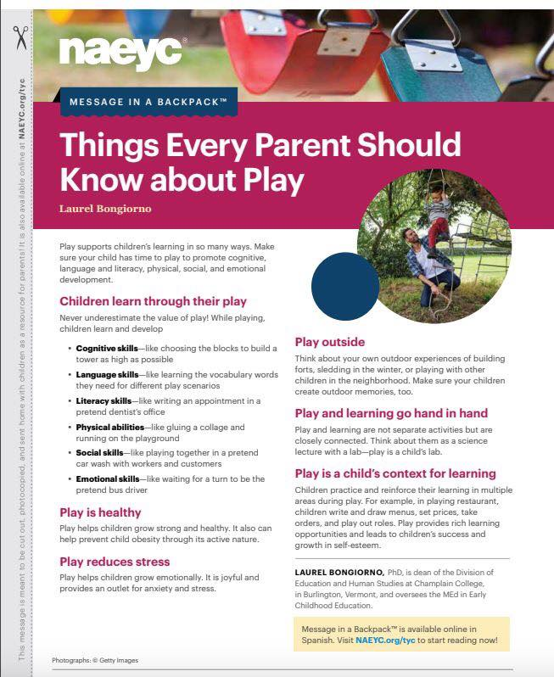
How do the children learn in P1?
Play continues to be an important part of children’s learning.

Slide 4
Early Reading and Writing How can you support your child as they develop their reading and writing skills?
Notes:
This resource introduces how families can support their child’s development within the four developmental continua; Concepts of Print, Phonological Awareness,
The structure is as follows:
Introduction to Developmental Approaches
Phonological Awareness
Oral Language
Fine Motor Skills
In this slide, the facilitator should share the purpose of the session, e.g.
‘Good morning/ afternoon/ evening, thank you for coming along. This morning’s/ afternoon’s/ evening’s session is going to look at how we can work together to support your child to develop their reading and writing skills.’
Emerging Literacy is the term used to explain a child’s knowledge of reading and writing skills before they learn how to read and write words.

Slide 5
Concepts of Print
Phonological Awareness
Oral Language
Fine Motor Skills
Notes:
The facilitator should share:
‘When we teach reading and writing skills, the majority of these are able to fit into one of these four boxes. For example:
Concepts of Print might include:
Know to write from left to write
Know what each of the letters look like
Phonological Awareness might include:
Know the sounds which make up each of the words
Hear the individual words within the sentence
Listen to and recall the words within the sentence
Oral Language might include:
Understand the meaning of the words within the sentence
Can follow the instructions to complete the activity
Fine Motor Skills might include:
Hold the pen correctly
Form the letters correctly

Slide 6
Rhyme
Little Miss Muffet,
Sat on a tuffet,
Eating her curds and whey,
Along came a spider,
And sat down beside her,
Scaring Miss Muffet away
Phonological Awareness
Notes:
Facilitator to share:
‘When developing phonological awareness skills, we will develop a number of skills including your child’s ability to listen to instructions, their ability to hear and produce rhyme, their awareness of the syllables within words and their awareness of the sounds within words.
At home, one way you can support your child’s phonological awareness is through developing their rhyming skills. This can be developed through:
Sharing nursery rhymes
Reading rhyming books
Making up rhymes together
Supporting your child in creating rhyming words’
Phonological Awareness page: http://highlandliteracy.com/emerging-literacy/phonological-awareness/

Slide 7
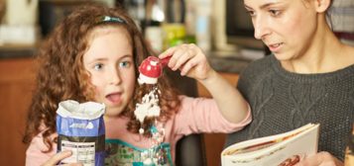
Playing with your child for ten minutes a day will support the development of your child’s oral language.
Oral Language
Notes:
Oral Language (10 mins approx.)
Facilitator to share:
‘When you are talking to someone, what are some of the things that people do when they’re not giving you their full attention?’
Some suggestions may include:
No eye-contact
Distracted by a phone/ TV/ computer etc.
Listening to another conversation
Talking over you when you are talking
Showing no interest in what you’re saying
Facilitator to share:
‘In comparison, when you’re talking with someone, what things do they do to show you that they are giving you their full attention?’
Some suggestions may include:
Giving you eye-contact
Sitting close to you
Turning off a phone/ TV/ computer etc.
Finding a quiet space to talk
Allowing you to finish before they talk
Showing that they’re interested by smiling and nodding
Facilitator to share:
‘So, when you’re playing with your child, what are some of the things you do to ensure that they have your full attention?’
Some suggestions may include:
Playing beside them
Giving them eye-contact
Turning off a phone/ TV/ computer etc.
Finding a quiet space
Allowing them to finish before you talk
Showing that you’re interested by smiling and nodding
Facilitator to share:
‘It is important that all of these things are in place to support your child’s language development. You will support your child’s language through allowing them to hear and use familiar and new words within different activities. Playing alongside your child for ten minutes a day will support the development of your child’s oral language’.

Slide 8
Fine Motor Skills
Notes:
Fine Motor Skills (10 mins approx.)
Facilitator to share:
‘In school we aim to support your child in developing big movements, known as gross motor skills, through indoor and outdoor physical and play activities. We also aim to aim to support your child’s small movements, known as fine motor skills through a number of fine motor, scissor and pre-handwriting activities.
Some things which you may do at home to support your child are:
Provide them with opportunities to use scissors to cut out shapes and patterns
Provide them with big paper and drawing implements
Allow them to make marks outside with paint brushes and water or large chalks
Create a chain with pasta and a shoe lace
Create objects using dough
Make finger puppets
Put coins into a money box
Turn a deck of cards over as quickly as they can
Hammering
Squeezing bubble wrap
Playing with wind-up toys
The facilitator should have example resources (as detailed above; including any other relevant fine motor resources) available. Facilitators may also wish to provide families with the Fine Motor Skills activities from the Pre-Handwriting page (you could focus on pg.9) on the Highland Literacy Blog.
Pre-Handwriting page: http://highlandliteracy.com/emerging-literacy/pre-handwriting/
Fine Motor Skills support: https://highlandliteracy.files.wordpress.com/2015/12/play-fine-motor-skills.pdf

Slide 9
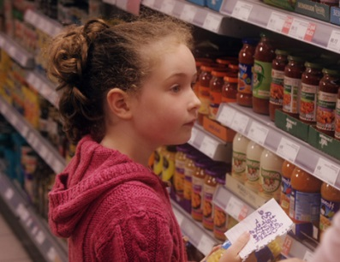
www.readwritecount.scot
Concepts
of Print
Notes:
Concepts of Print (10 mins approx.)
The facilitator should have a number of different picture books available for families to look through.
Facilitator to share:
‘To develop your child’s awareness of print, it is recommended that you read to your child every day. You may read lots of different stories or you may read their favourite story again and again. Reading with your child for ten minutes each day will have a positive impact on their awareness of print. When reading with your child, sit beside them, allow them to see the pages and point out the pictures, modelling the reading process.’
Facilitator to share:
‘When out and about, point out food labels, road signs and shop signs or visits to the library.

Slide 10
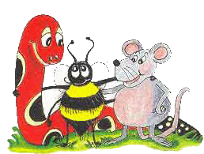
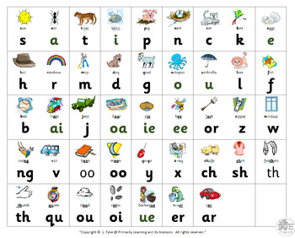
Literacy at Turriff Primary School Primary 1
Phonological Awareness Assessments
Start learning initial letter sounds. SATPIN
Two letter sounds per week with a range of teacher led and play activities to support the learning.
At this stage we focus on class stories and follow-up activities. Once the pupils have a grasp of most initial sounds and common words we begin guided reading groups which you can learn more about in our Reading workshop later in the year.
Big Writing

