Slide 1
Turriff Primary P1 Curricular Evening for Parents/Carers Wednesday 6th September 6.30pm PRESENTATION 4

Slide 2
Learning Across the Curriculum
In Primary 1 we have a balance of teacher planned experiences and pupil led experiences. Our planned topics generally link to the seasons and festivals that occur throughout the year. Currently we are learning about our school, our families and people who help us learn and keep us safe. We also start to learn French and will celebrate French Fridays by learning basic vocabulary through songs and stories.

Slide 3
Learning Across the Curriculum
For Health and Wellbeing we follow the Bounceback program which focuses on social skills and values.
We also use the RSHP scheme which focuses on physical health and hygiene.
We also spend a lot of time learning about the school values and the Golden Rules to make sure we stay safe and happy in school.
We have two PE sessions per week. Our focus this term is small equipment play and team games.

Slide 4
How to Support Your Child at Home
Nursery Rhymes and Songs
Stories – encourage retelling of stories, looking at the pictures for clues, reading from left to right.
Look for phonics sounds and numbers in the environment.
Practising changing for PE independently and hanging a jacket on a hanger.
Recognising their name.
Discussing the lunch menu at home

Slide 5
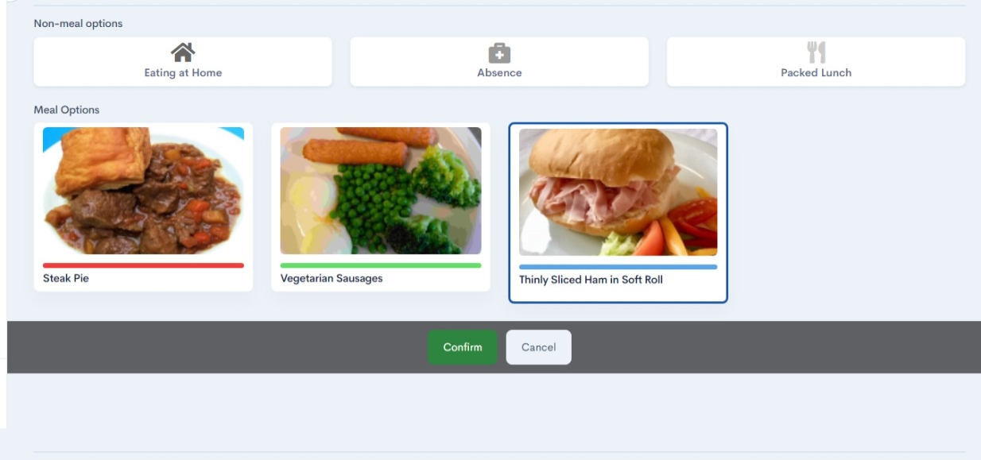

Slide 6
How do we Celebrate Successes? –
Houses and House Points:
Delgaty - Green, Craigston - Blue, Forglen – Red and Hatton – Yellow
Celebrating successes in class. Positive Relationships Policy – Happy, Respecting, Achieving.
Class and School Newsletters
Teacher Awards at assemblies and the Golden Book
Wider Achievement Days – One per term
Open Sessions (Afternoons and Evenings, Community Cafe)
End of year awards ceremony
Social media, local press etc.
Super 7 Characters
Check the school website regularly

Slide 7
Questions and Feedback
Please follow our School Social media pages:
Turriff Primary

